Slide 1

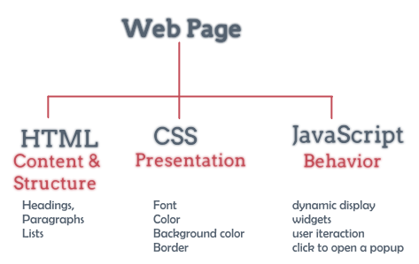
Cascading Style Sheets (CSS) Part 2

Slide 2
Lesson Objectives
Master the techniques of Layout and positioning

Slide 3
Lesson content
Box
Margin
Padding
display
Position
Floating

Slide 4
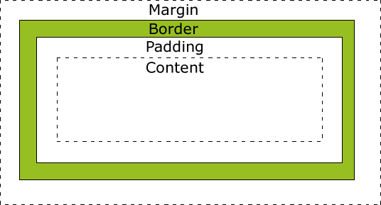
Box
Box: the elements surrounding the HTML element:

Slide 5
Box
Total element width =
width +
padding-left + padding-right +
border-left + border-right +
margin-left + margin-right
width: 250px;
margin: 10px;
padding: 20px;
border: 5px solid #000000
320px

Slide 6
Box
Total element height =
height +
padding-top + padding-bottom +
border-top + border-bottom +
margin-top + margin-bottom
height: 200px;
margin: 10px;
padding: 20px;
border: 5px solid #000000
???px

Slide 7
Margin
Values: auto (browser calculates), px, %, inherit (inherits from the element containing it)
Can declare negative numbers
Attributes
margin-top
margin-bottom
margin-left
margin-right
margin: top right bottom left

Slide 8
Margin
margin-top: 10px;
margin-bottom: 20px;
margin-left: 5px;
margin-right: 15px
margin: 10px 15px 20px 5px;
margin-top: 10px;
margin-bottom: 20px;
margin-left: 15px;
margin-right: 15px;
margin: 10px 15px 20px;
margin-top: 10px;
margin-bottom: 10px;
margin-left: 15px;
margin-right: 15px;
margin: 10px 15px;
margin-top: 10px;
margin-bottom: 10px;
margin-left: 10px;
margin-right: 10px
margin: 10px;

Slide 9
Padding
Value: px, %
Attributes
padding-top
padding-bottom
padding-right
padding-left
padding: top right bottom left

Slide 10
Padding
padding-left: ?px;
padding-right: ?px;
padding-top: ?px;
padding-bottom: ?px;
padding: 5px 10px 15px 20px
padding-left: ?px;
padding-right: ?px;
padding-top: ?px;
padding-bottom: ?px;
padding: 5px 10px 20px
padding-left: ?px;
padding-right: ?px;
padding-top: ?px;
padding-bottom: ?px;
padding: 5px 10px

Slide 11
Display
Block element: occupy a whole row
div, h1, li…
Inline element: occupies only 1 area in the row
span, a,…
display: block/inline
change the display of element

Slide 12
Position
position: declare the locator type for element
static: positioned by default
relative: relative positioning
fixed: fixed positioning
absolute: fixed positioning based on the nearest parent whose position is not static
left, right, top, bottom: locate the element relative to the boundaries

Slide 13
Floating
float: the next element will be pushed next to the float element (left or right).
left
right
clear: clear the float
left
right
both

Slide 14
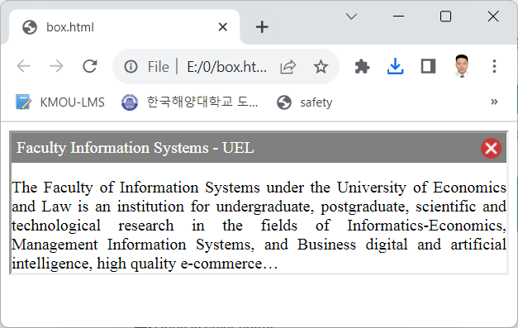
Example of making Box

Slide 15
Example of making Box
<style>
/* The alert message box */
.alert {
padding: 5px;
background-color: grey;
color: white;
margin-bottom: 15px;
}
.borderdiv
{
border:inset;
text-align:justify
}
</style>

Slide 16
Example of making Box
<style>
.closebtn {
margin-left: 15px;
color: white;
font-weight: bold;
float: right;
font-size: 22px;
line-height: 20px;
cursor: pointer;
transition: 0.3s;
}
</style>

Slide 17
Example of making Box
<div class="borderdiv">
<div class="alert ">
<span class="closebtn"
onclick="this.parentElement.parentElement.style.display = 'none';">
<img src="close.png"/>
</span>
Faculty Information Systems - UEL
</div>
The Faculty of Information Systems under the University of Economics and Law is an institution for undergraduate, postgraduate, scientific and technological research in the fields of Informatics-Economics, Management Information Systems, and Business. digital and artificial intelligence, high quality e-commerce…
</div>

Slide 18


Hey! Coding is easy!
END

